Slide 1
Overfitting and Underfitting
Abhijit Ramesh Patil

Slide 2
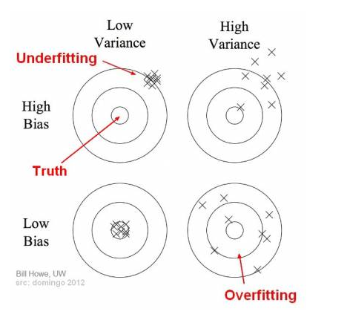
Define Bias and Variance
Bias : Bias mean error of the training data
Variance : Error of the testing data

Slide 3
Bias : The difference between the average value predicted by ML model and the correct target value is known as Bias.
Characteristics
Underfitting: A model with high bias tends to underfit.
Oversimplification: Due to model being too simple, the biased model is unable to learn complex feature
Low training accuracy
Solution to high bias :
Add more feature to make model more complex
Increase training iteration
Use non linear algorithm

Slide 4
Variance : The amount of variability in target function in response to a change in the training data is called variance
Characteristics
Overfitting: A model with high variance tend to overfit
Overcomplication: Due to model being too complex, the model learns much more complex curve.
Low testing accuracy
Solution to high variance :
Reducing features
Increasing training data
Replacing current model with a simpler model
Use lower degree algorithm
Use hyperparameter tuning
Increase regularization

Slide 5
What is Generalised model ?
A model is to be said Generalised model if it carries following characteristics :
Accuracy during training as well as testing is very high.
It is able to perform well on training and testing data set
For the best model – High accuracy during training as well as high accuracy during testing.
Low training error
Low testing error
Low Bias
Low Variance

Slide 6
What is overfitting ?
Accuracy during training is very high but accuracy during testing is very low then this condition is called overfitting.
It is able to perform well on training data set but it does not perform well on testing data set
Low training error
High testing error
Low Bias
High Variance
We try to convert high variance to low variance by applying some hyperparameter tuning.
Overfitting is avoided by
Cross validation, Training with more data, Removing features, Regularization

Slide 7
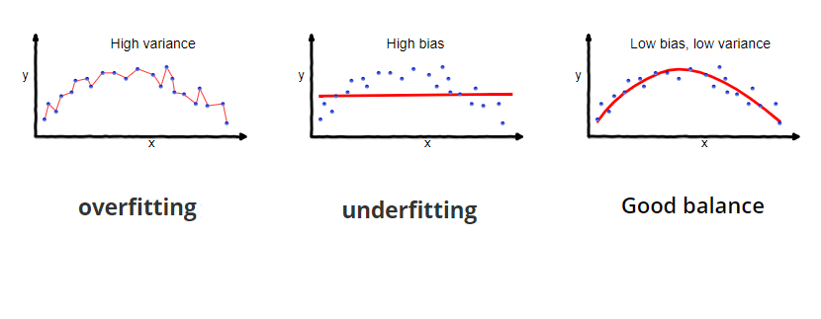

Slide 8
What is bias variance trade off ?
The model which is neither underfitting nor overfitting is called as bias variance trade off.
If the model uses simple machine learning algorithm then model will have high bias and low variance (Underfitting)
If the model follows complex machine learning model then it will have high variance and low bias (Overfitting)
We need to find good balance between bias and variance of model we have used. An optimal balance of bias and variance should never overfit or underfit the model.
This trade off applies to all forms of supervised learning.

